Slide 1
Copyright Notice
These slides are distributed under the Creative Commons License.
DeepLearning.AI makes these slides available for educational purposes. You may not use or distribute these slides for commercial purposes. You may make copies of these slides and use or distribute them for educational purposes as long as you cite DeepLearning.AI as the source of the slides.
For the rest of the details of the license, see https://creativecommons.org/licenses/by-sa/2.0/legalcode

Slide 2


Math for Machine Learning
Linear algebra - Week 2
Solving systems of equations Matrix row reduction
Row operations that preserve singularity Row-reduced echelon form
Row echelon form Rank of a matrix

Slide 3
Solving System of Linear Equations
Machine learning motivation

Slide 4

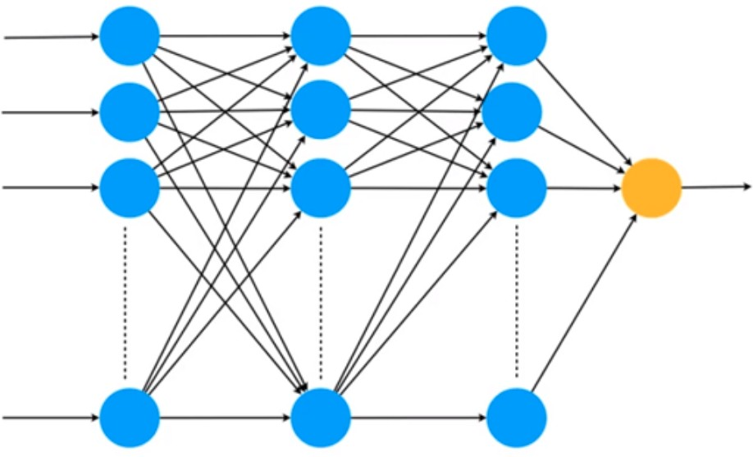









Neural networks - Matrix operations
"Hello! Welcome to Math for Machine Learning!"
Matrix
Matrix
Matrix
Matrix

Slide 5
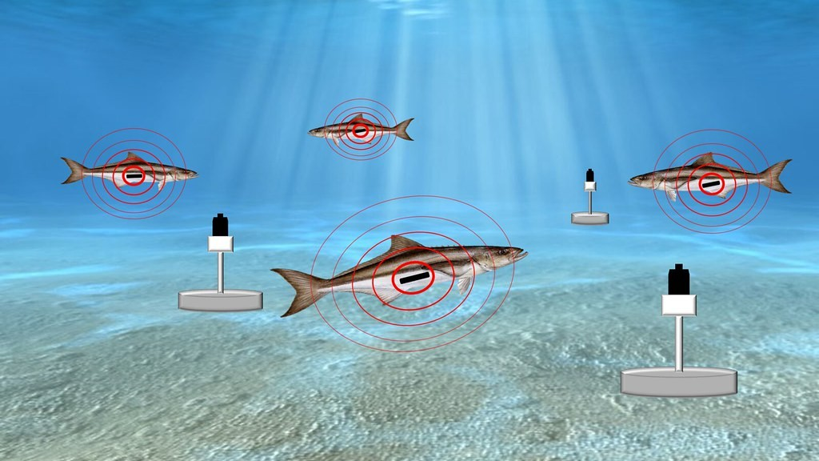
Neural networks - Sound recognition
Acoustic monitoring: Monitoring ecosystems through sounds
Sound recognition: tracking species through sound to preserve bio-habitats.

Slide 6
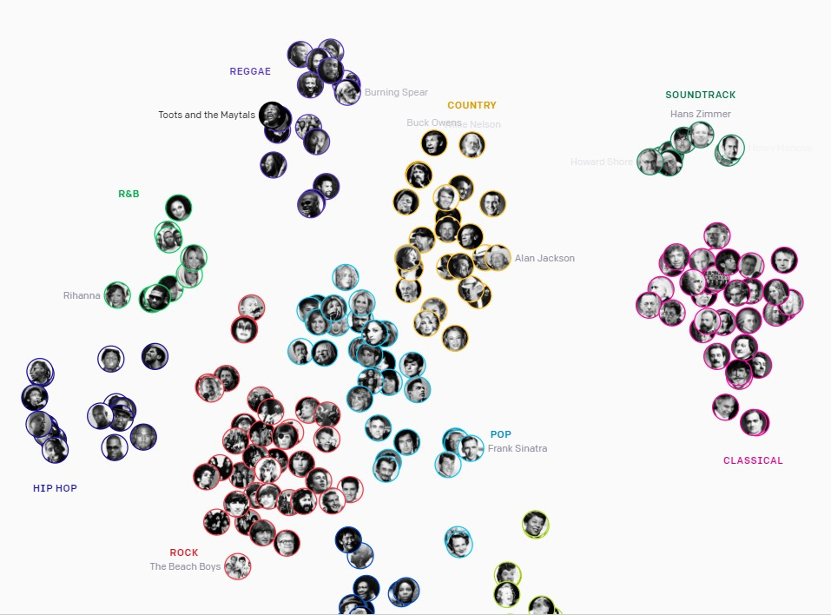


Neural Networks - AI-generated music
Neural network generates music
Automatic music generation: compressing music to discrete codes, then training the model on a specific genre to produce new music.

Slide 7
Solving System of Linear Equations
Solving non-singular system of linear equations

Slide 8




Solving systems of equations
System
+
= $10
a + b = 10
$8
$2
a + 2b = 12
+
+
= $12
$2

Slide 9
Solving systems of equations
System
Solved system
Some process
a + b = 10
a = 8
Manipulating equations
a + 2b = 12
b = 2
Swapping equations Adding equations
Multiplying equations by a constant

Slide 10

Solving systems of equations
System
Solved system
a + b = 10
a = 8
a + 2b = 12
b = 2
Eliminate ‘a’ from this equation

Slide 11



Manipulating equations

Slide 12
Let’s do a harder example

Slide 13









Systems of equations

Slide 14




Systems of equations
System
Divide by coefficient of a
Solved system
a = 3
5a + b = 17
a + 0.2b = 3.4
?
b = 2
4a - 3b = 6
a - 0.75b = 1.5
?
Subtract equation 1 from equation 2
a - 0.75b = 1.5
Eliminate ‘a’ from this equation
-
a + 0.2b = 3.4
a + 0.2(2) = 3.4
a + 0.4 = 3.4
a = 3
0a - 0.95b = - 1.9
-0.95b = - 1.9
b = 2

Slide 15


What if one of the coefficients of a is zero?
System
Solved system
5a + b = 17
3b = 6
a = ?
b = ?

Slide 16


What if one of the coefficients of a is zero?
System
Divide by coefficient of a
Solved system
5a + b = 17
3b = 6
a + 0.2b = 3.4
a = 3
?
???
b = 2
?
Eliminate ‘a’ from this equation
b = 2
a + 0.2(2) = 3.4
a + 0.4 = 3.4
a = 3

Slide 17



Quiz
Solve the following system of equations
System
2a + 5b = 46
8a + b = 32

Slide 18
Solving System of Linear Equations
Solving singular system of linear equations

Slide 19



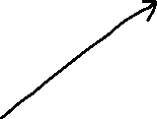

What if the system is singular (redundant)?
System
Divide by coefficient of a
Solved system
a + b = 10
a + b = 10
a = ?
2a + 2b = 20
a + b = 10
b = ?
Subtract equation 1 from equation 2
Eliminate ‘a’ from this equation
a + b = 10
Solved system
-
a + b = 10
a + b = 10
0 = 0
no other equation

Slide 20



What if the system is singular (contradictory)?
System
Solved system
a + b = 10
a = ?
2a + 2b = 24
b = ?

Slide 21






Quiz
Solve the following system of equations
System
5a + b = 11
10a + 2b = 22

Slide 22
Solving System of Linear Equations
Solving system of equations with more variables

Slide 23
Elimination method
System
a + b + 2c = 12
3a - 3b - c = 3
2a - b + 6c = 24

Slide 24








Elimination method
System
a + b + 2c = 12
3a - 3b - c = 3
2a - b + 6c = 24
Leave ‘a’ by itself

Slide 25




Elimination method
System
a + b + 2c = 12
a + b + 2c = 12
a + b + 2c = 12
3a - 3b - c = 3
a - b - 1/3 c = 1
-2b - 7/3 c = -11
2a - b + 6c = 24
a - b/2 + 3c = 12
- 3/2 b + c = 0
Divide each row by the coefficient of ‘a’
Use the first equation to remove ‘a’ from the others
Isolated ‘a’
Solve this new system of 2 equations

Slide 26




Elimination method
System
a + b + 2c = 12
a + b + 2c = 12
a + b + 2c = 12
-2b - 7/3 c = -11
b + 7/6 c = 11/2
b + 7/6 c = 11/2
- 3/2 b + c = 0
b - 2/3 c = 0
•
-11/6 c = -11/2
Divide last two rows by the coefficient of b
Use the second equation to remove ‘b’ from the third
Isolated ‘b’
c = 3

Slide 27
Elimination method
System
a + 2 + 6 = 12
a = 4
a + b + 2c = 12
b + 7/6 c = 11/2
b + 7/2 = 11/2
b = 2
•
c = 3
Replace c = 3 in the second equation, get b = 2
Replace c = 3 and b = 2 in the first equation, get a = 4
The solution is a = 4
b = 2
c = 3

Slide 28
Solving System of Linear Equations
Matrix row reduction

Slide 29



Systems of equations to matrices
Original system
Intermediate System
Solved system
5a + b = 17
a + 0.2b = 3.4
b = 2
1a + 0b = 3
• a = 3
• b = 2
4a - 3b = 6
0a + 1b = 2
Original matrix
Upper diagonal matrix
Diagonal matrix
5
1
1
0.2
1 | 0
0 | 1
4
-3
0
1
Row echelon form
Reduced row echelon form

Slide 30
Systems of equations to matrices
Original system Intermediate System
• a + b = 10 • a + b = 10
• 2a + 2b = 20 • 0a + 0b = 0
Original matrix
Upper diagonal matrix
1
1
1 | 1
0 | 0
2
2
Row echelon form

Slide 31




Systems of equations to matrices
Original system
5a + b = 11
10a + 2b = 22

Slide 32
Systems of equations to matrices
Original system Intermediate System
• 5a + b = 11 • a + 0.2b = 2.2
• 10a + 2b = 22 • 0a + 0b = 0
Original matrix
Upper diagonal matrix
5
1
1 | 0.2
0 | 0
10
2
Row echelon form

Slide 33
Systems of equations to matrices
Original system Intermediate System
• 0a + 0b = 0 • 0a + 0b = 0
• 0a + 0b = 0 • 0a + 0b = 0
Original matrix
Upper diagonal matrix
0
0
0 | 0
0 | 0
0
0
Row echelon form

Slide 34




Slide 35
Solving System of Linear Equations
Row operations that preserve singularity

Slide 36


Switching rows
5 | 1
4 | 3
4 | 3
5 | 1
Determinant
Determinant

Slide 37
Multiplying a row by a (non-zero) scalar
5 | 1
4 | 3
5
1
x 10 =
50
10
50 | 10
4 | 3
Determinant
Determinant = 5 ⋅ (10 ⋅ 3) − 1 ⋅ (10 ⋅ 4)

Slide 38

Adding a row to another row
5 | 1
4 | 3
5 | 1
4 | 3
+
9 | 4
4 | 3
9
4
Determinant
Determinant

Slide 39




Slide 40

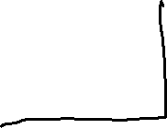


Slide 41










Solving System of Linear Equations
Rank of a matrix

Slide 42

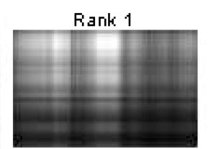
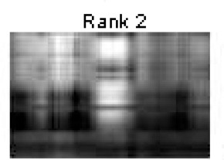
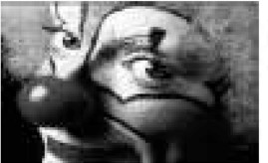
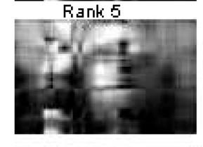
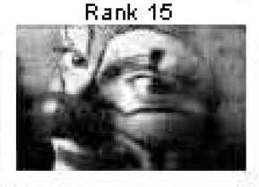
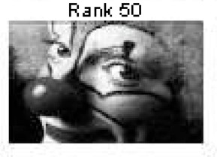


Compressing Images - Reducing rank

Slide 43


Systems of information
System 1 | System 2 | System 3
The dog is black | The dog is black | The dog
The cat is orange | The dog is black | The dog
Two sentences | Two sentences | Two sentences
Two pieces of information | One piece of information | Zero pieces of information
Rank = 2 | Rank = 1 | Rank = 0

Slide 44



Systems of equations
System 1 System 2
a + b = 0 a + b = 0
a + 2b = 0 2a + 2b = 0
System 3
1 | 1
1 | 2
1 | 1
2 | 2
0a + 0b = 0
0 | 0
0 | 0
0a + 0b = 0
Rank = 2
Rank = 1
Rank = 0
Two equations Two pieces of information | Two equations One piece of information | Two equations Zero pieces of information
Rank = 2 | Rank = 1 | Rank = 0

Slide 45




Rank and solutions to the system
1 | 1
1 | 2
1 | 1
2 | 2
0 | 0
0 | 0
Rank = 2
Dimension of solution space = 0
Rank = 1
Dimension of solution space = 1
Rank = 0
Dimension of solution space = 2
b
b
b
(0,0)
a
a
a

Slide 46
Rank of a matrix
1 | 1
1 | 2
1 | 1
2 | 2
0 | 0
0 | 0
Rank = 2
Dimension of solution space = 0
Rank = 1
Dimension of solution space = 1
Rank = 0
Dimension of solution space = 2
Rank = 2 - (Dimension of solution space)

Slide 47

Rank and singularity
1 | 1
1 | 2
1 | 1
2 | 2
0 | 0
0 | 0
Rank = 2
Rank = 1
Rank = 0
Non-singular
Singular
Singular

Slide 48











Quiz: Rank of a matrix
Determine the rank of the following two matrices
Matrix 1
5 | 1
-1 | 3
Matrix 2
2 | -1
-6 | 3

Slide 49
Solving System of Linear Equations
Rank of a matrix: General case

Slide 50






Rank for matrices
System 1 | System 2 | System 3 | System 4
a + b + c = 0 | a + b + c = 0 | a + b + c = 0 | 0a + 0b + 0c = 0
a + 2b + c = 0 | a + b + 2c = 0 | 2a + 2b + 2c = 0 | 0a + 0b + 0c = 0
a + b + 2c = 0 | a + b + 3c = 0 | 3a + 3b + 3c = 0 | 0a + 0b + 0c = 0
3 Equations | 3 Equations | 3 Equations | 3 Equations
3 Pieces of information | 2 Pieces of information | 1 Piece of information | 0 Pieces of information
Rank 3 | Rank 2 | Rank 1 | Rank 0
1 | 1 | 1
1 | 2 | 1
1 | 1 | 2
1 | 1 | 1
1 | 1 | 2
1 | 1 | 3
1 | 1 | 1
2 | 2 | 2
3 | 3 | 3
0 | 0 | 0
0 | 0 | 0
0 | 0 | 0

Slide 51
Question
Is there an easier way to calculate the rank?
Answer: Yes! As before, it is the number of ones in the diagonal of the reduced row echelon form of the matrix.

Slide 52
Solving System of Linear Equations
Row echelon form

Slide 53
Row echelon form of a matrix
Original matrix
Row echelon form
5 | 1
4 | -3
5 | 1
10 | 2
0 | 0
0 | 0
1 | 0.2
0 | 1
1 | 1
0 | 0
0 | 0
0 | 0
0 | 0
0 | 0

Slide 54
Row echelon form
Original matrix
Row echelon form
5 | 1
4 | -3
1 | 0.2
1 | -0.75
1 | 0.2
0 | -0.95
1 | 0.2
0 | 1
Divide each row by the leftmost coefficient
1
-0.75
Divide the second row by the leftmost non-zero coefficient
-
1
0.2
0
-0.95

Slide 55
Row echelon form for singular matrices
Original matrix
Row echelon form
5 | 1
10 | 2
1 | 0.2
1 | 0.2
1 | 0.2
0 | 0
1 | 0.2
? | ?
Divide each row by the leftmost coefficient
1 | 0.2
1 | 0.2
Divide the second row by the leftmost non-zero coefficient
-
0
0

Slide 56
Row echelon form for singular matrices
Row echelon form Original matrix
0 | 0
0 | 0
? | ?
? | ?
Divide each row by the leftmost coefficient

Slide 57

Row echelon form, singularity, and rank
Rank 2
2 ones in the diagonal
5 | 1
4 | -3
1 0.2
Non-singular matrix
0
1
Rank 1
1 one in the diagonal
5 | 1
10 | 2
1 0.2
Singular matrix
0
0
Rank 0
0 ones in the diagonal
0 | 0
0 | 0
0
0
Singular matrix
0
0

Slide 58















Slide 59
Solving System of Linear Equations
Row echelon form: General case

Slide 60
Row echelon form
System
System
a + b + 2c = 12
a + b + 2c = 12
3a - 3b - c = 3
-6b - 7c = -33
2a - b + 6c = 24
6c = 18
Row echelon form matrix
Matrix
1 | 1 | 2
3 | -3 | -1
2 | -1 | 6
1 | 1 | 2
0 | -6 | 7
0 | 0 | 6

Slide 61





Row echelon form
2
* * * *
3
*
*
*
*
Zero rows at the bottom
0
1
* * *
0
0
1
*
*
Each row has a pivot (leftmost non-zero entry)
0
0
3
* *
0
0
0
-4
*
0
0
0
-5
*
0
0
0
0
0
Every pivot is to the right of the pivots on the rows above
0
0
0
0
1
0
0
0
0
0
Rank 5
Rank 3
Rank of the matrix is the number of pivots

Slide 62











Slide 63
Another example
Matrix
Row echelon form
1 | 1 | 1
1 | 2 | 1
1 | 1 | 2
1 | 1 | 1
0 | 1 | 0
0 | 0 | 1
Subtract the first row from the second and the third ones

Slide 64
What if the matrix is singular?
Matrix
Row echelon form
1 | 1 | 1
1 | 1 | 2
1 | 1 | 3
1 | 1 | 1
0 | 0 | 1
0 | 0 | 2
1 | 1 | 1
0 | 0 | 1
0 | 0 | 0
Subtract the first row from the second and the third ones
Subtract twice the second row from the third one

Slide 65
What if the matrix is singular?
Matrix
Row echelon form
1 | 1 | 1
2 | 2 | 2
3 | 3 | 3
1 | 1 | 1
0 | 0 | 0
3 | 3 | 3
1 | 1 | 1
0 | 0 | 0
0 | 0 | 0
Subtract twice the first row from the second row
Subtract three times the first row from the third row

Slide 66
Rank for matrices
Matrix 1 Matrix 2
Matrix 3
Matrix 4
1 | 1 | 1
1 | 2 | 1
1 | 1 | 2
1 | 1 | 1
1 | 1 | 2
1 | 1 | 3
1 | 1 | 1
2 | 2 | 2
3 | 3 | 3
0 | 0 | 0
0 | 0 | 0
0 | 0 | 0
Rank = 3
Rank = 2
Rank = 1
Rank = 0
Row echelon forms
1 | 1 | 1 |  | 1 | 1 | 1 |  | 1 | 1 | 1
0 | 1 | 0 |  | 0 | 0 | 1 |  | 0 | 0 | 0
0 | 0 | 1 |  | 0 | 0 | 0 |  | 0 | 0 | 0
0 | 0 | 0
0 | 0 | 0
0 | 0 | 0
Number of pivots = 3
Number of pivots = 2
Number of pivots = 1
Number of pivots = 0

Slide 67


Solving System of Linear Equations
Reduced row echelon form

Slide 68

Systems of equations to matrices
Original system
Intermediate System
Solved system
5a + b = 17
a + 0.2b = 3.4
b = 2
1a + 0b = 3
• a = 3
• b = 2
4a - 3b = 6
0a + 1b = 2
Original matrix
Upper diagonal matrix
Diagonal matrix
5
1
1
0.2
1 | 0
0 | 1
4
-3
0
1
Row echelon form
Reduced row echelon form

Slide 69



Reduced row echelon form
Row echelon form
1 | 0.2
0 | 1
1 | 0
0 | 1
0
1
1 | 0.2
0 | 0.2
x
0.2
-
0
0.2
1
0

Slide 70




Reduced row echelon form
1
0
0
0
0
1
* 0
0
*
Is in row echelon form
0
1
0
0
0
0
0
1
0
*
Each pivot is a 1
0
0
1
0
0
0
0
0
1
*
Any number above a pivot is 0
0
0
0
1
0
0
0
0
0
0
0
0
0
0
1
0
0
0
0
0
Rank of the matrix is the number of pivots
Rank 5
Rank 3

Slide 71




Reduced row echelon form
Reduced row echelon form
Row echelon form
3 | * | * | * | * |  | 1 | * | * | * | * |  | 1 | * | 0 | 0 | *
0 | 0 | 2 | * | * |  | 0 | 0 | 1 | * | * |  | 0 | 0 | 1 | 0 | *
0 | 0 | 0 | -4 | * |  | 0 | 0 | 0 | 1 | * |  | 0 | 0 | 0 | 1 | *
0 | 0 | 0 | 0 | 0 |  | 0 | 0 | 0 | 0 | 0 |  | 0 | 0 | 0 | 0 | 0
0 | 0 | 0 | 0 | 0 |  | 0 | 0 | 0 | 0 | 0 |  | 0 | 0 | 0 | 0 | 0
Divide each row by the value of the pivot
Turn anything above a pivot to 0

Slide 72
Reduced row echelon form
Reduced row echelon form
Row echelon form
1 | 2 | 3
0 | 1 | 4
0 | 0 | 1
1 | 0 | -5
0 | 1 | 4
0 | 0 | 1
1 | 0 | 0
0 | 1 | 4
0 | 0 | 1
1 | 0 | 0
0 | 1 | 0
0 | 0 | 1
Subtract 2 times the second row from the first one
Add 5 times the third row to the first one
Subtract 4 times the third row from the second one

Slide 73
Solving System of Linear Equations
Conclusion

